Slide 1
HITTING THE TARGET
CREATING BETTER BUILDINGS THROUGH WHOLE BUILDING ENERGY PERFORMANCE MODELING
Maria Karpman, Karpman Consulting
Anthony Clark, Connecticut Green Bank

Slide 2
Learning objectives
Identify common applications of energy modeling
Describe purpose and scope of ASHRAE Standard 209: Energy Simulation - Aided Design
Discuss the importance of energy modeling as a tool for improving building design and performance
Understand why modeled building performance may differ from actual energy use
Learn about financial resources unlocked by pursuing whole building energy modeling

Slide 3
Why Energy Modeling Matters

Slide 4
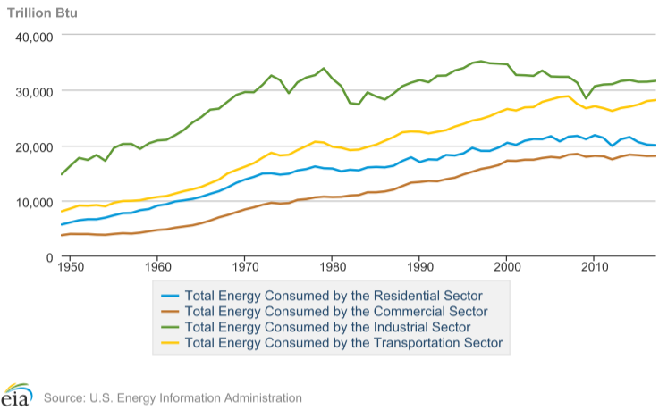
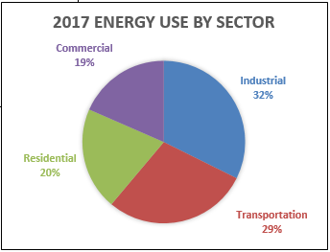
Energy Consumption by Sector
Notes:
Buildings consume more energy than any other sector of American economy.
The general trend has been a steady increase in building energy use since 1950. They don’t build them like they used anymore, right? Not necessarily. The population is increasing, and buildings now house more technology than they used to (think IT equipment). The bottom line is that buildings are the largest consumer in the economy and this makes detailed analysis and optimization of building energy efficiency a worthwhile and even necessary endeavor.
The importance of building energy usage to our economy’s overall energy usage provides the justification to invest in energy modeling

Slide 5
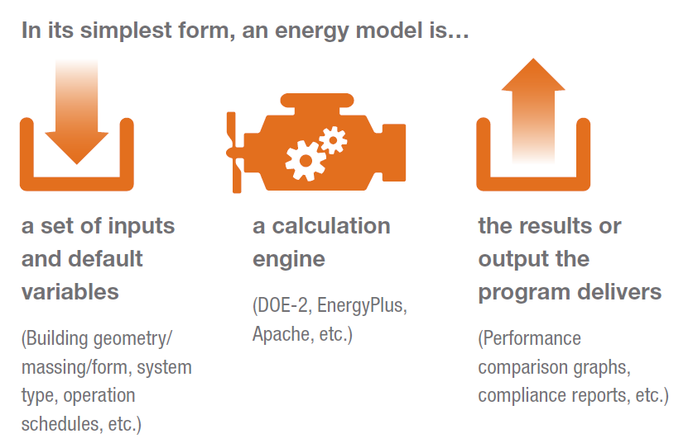
What is Energy Modeling?
5
Notes:
Calculation engines run simulations hourly
Some are publicly funded, some are developed by private entities
Some tools are privately developed interfaces to publicly funded calculation engines

Slide 6
Energy modeling CONTEXT
Traditionally and for the most part used as an accounting tool
Sustainable building credits
Utility incentives awards
Code compliance
Tax credits
Some programs have limited quality control
Wild West / Gold Rush days
Typically not used to influence design

Slide 7
Common Applications of Energy Modeling

Slide 8
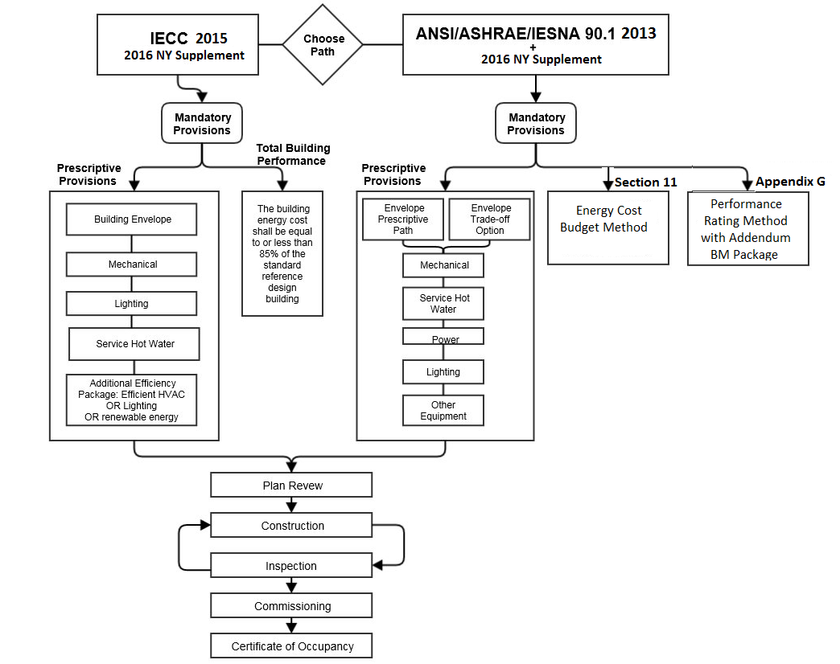
Code Compliance
IECC 2015 w/CT Amendments
ASHRAE 90.1 2013 w/CT Amendments
8
Notes:
New code in effect from Oct 1 2018
CT amendment adds compliance option via 90.1 App G
App G is the most widely used protocol

Slide 9
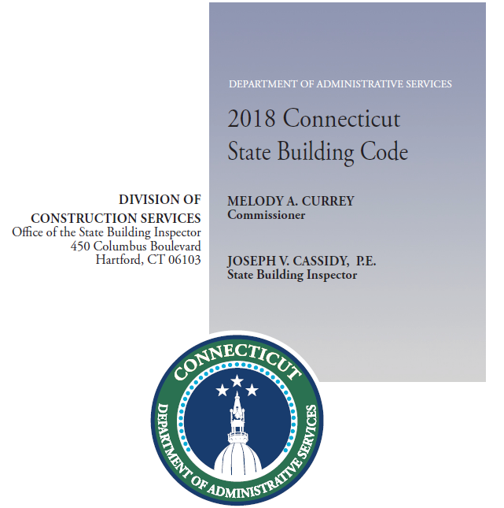
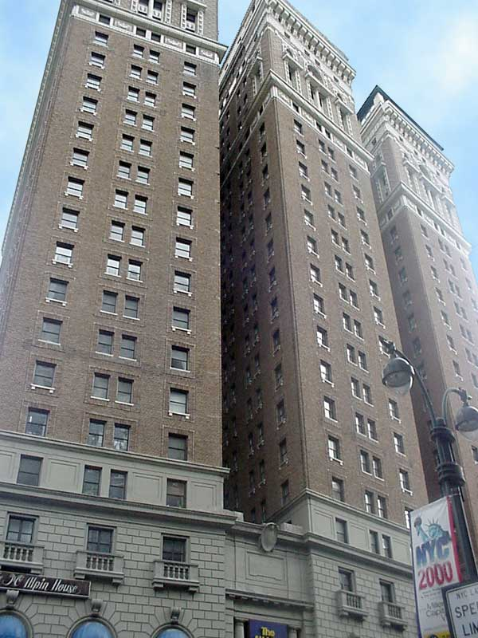
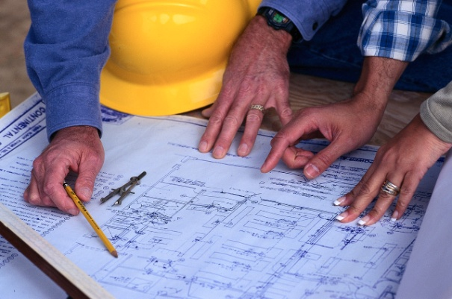
General Concept of performance-based compliance paths
Proposed design model developed following the rules of the selected compliance path
Model of a virtual building (reference design, baseline, energy budget) developed following the rules of the selected compliance path
Notes:
Performance Path was in standard 90 since the first edition (90-75). It offers flexibility by allowing a designer to “trade off” compliance by not meeting some prescriptive requirements if the impact on energy cost can be offset by exceeding other prescriptive requirements.
A computer simulation of a proposed building design is compared to a reference building design (baseline, budget) that is essentially a clone of the proposed design with each building component adjusted to “just meet” prescriptive requirements (the rules and trade-off opportunities are different for each compliance path). A building is deemed in compliance when the annual energy cost of the proposed design is no greater than the annual energy cost of the reference building design. Instead of looking at components in isolation, this method allows recognition of the interactions of those components in demonstrating compliance.

Slide 10
LEED NC 2009
Energy and Atmosphere Prerequisite 2: Minimum Energy Performance
Demonstrate the minimum required improvement relative to ASHRAE Standard 90.1 2007
Energy and Atmosphere Credit 1: Optimize Energy Performance
Points for improving over the required minimum energy performance
Integrative Process (Pilot Credit)
1 point for early energy modeling and water budget analysis; use “simple box” energy model to explore how to reduce energy loads, analyzing any 2 of the following by end of SD:
site conditions building envelope massing & orientation | lighting levels thermal comfort ranges plug & process loads | program & operational parameters
Notes:
LEED used 90.1 Appendix G as the basis of the energy performance credits, which made the Appendix G protocol (The Performance Rating Method) the most widely used in the marketplace. In the early versions of LEED NC (2.2, 2009) the modeling was used to judge the efficiency of the final project design and calculate the associated energy points.

Slide 11
LEED v4: Shift in Modeling Focus
LEED NC 2009
EAc1: Demonstrate a percentage improvement in the proposed building performance compared with the baseline building performance
LEED NC v4
Analyze efficiency measures during the design process and account for the results in design decision making.
Establish an energy performance target (e.g kBtu per square foot-year of source energy use) no later than the schematic design phase.
Integrative Process credit (1 point) for energy modeling analysis before the completion of the schematic design phase.
Notes:
LEED V4 strives to shift the focus of energy modeling from accounting tool to design tool
Introduces performance target (post-construction energy use intensity)

Slide 12
Energy Modeling for Existing Buildings
Introduces actual use patterns, hours of operation, system performance, and real weather conditions into a model.
“Calibrated simulation” method trues up model by comparing the modeled energy use to the actual use (e.g. utility bills)
Common applications
estimate savings from energy conservation measures
select the most cost effective scope of retrofit
determine causes of discrepancies between predicted and actual energy use, to facilitate tuning of systems
Notes:
ASHRAE Guideline 14 and the International Performance Measurement & Verification Protocol (IPMVP) describe model calibration methodology

Slide 13
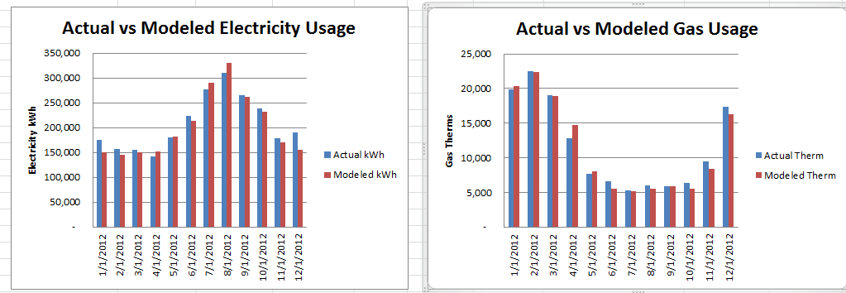
Calibrated Simulation
Comparing modeled energy use to the measured energy makes the model representative of the actual building performance
Utility bills are often the only measured data
Model calibration is an iterative process that involves evaluating building data collected during the audit, and adjusting the values that have highest uncertainty

Slide 14
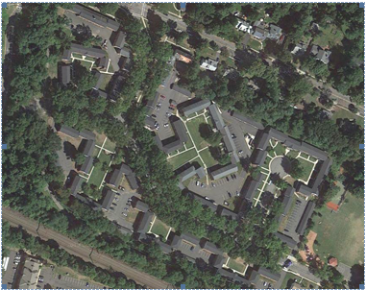
Incentive Program Example
270-unit / 19 building garden style multifamily complex
Must perform ASHRAE Level 2+ audit
The proposed retrofit must achieve 15% reduction in energy use based on calibrated simulation

Slide 15
Simulation Aided Design HOW ENERGY MODELING SHOULD BE USED

Slide 16
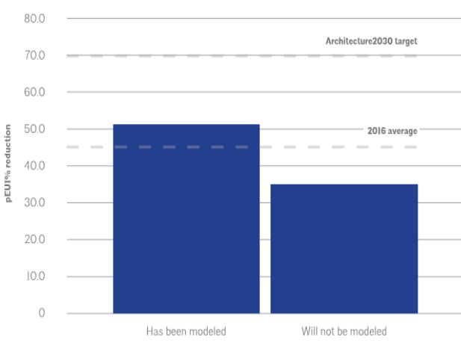
The AIA 2030 Commitment Report
“A standout finding from 2015 is the critical role of energy modeling in improving building design. Modeling early in the process helps ensure that there is greater interplay in the decision making between efficiency and aesthetics from the initial stages of a project.” 2014 AIA 2030 Progress Report
“… Projects using energy modeling predict an average of 16 percentage point more energy reduction” – 2030 by the Numbers – 2016, AIA 2030 Commitment Report
Notes:
: http://www.aia.org/aiaucmp/groups/aia/documents/pdf/aiab107447.pdf
Energy Simulation is the key to meeting the 2030 Challenge goals
This negates the need to either undo design decisions that have already been made in exchange for improved performance, or altogether forgo those options because the project is too far down the road.”
Modeling projects early informs the interplay between aesthetics and efficiency in the initial stages of the project. This helps avoid undoing early decisions or forgoing potential benefits
Modeling responsibilities vary based on type of project and design team
AIA encourages architects to incorporate modeling into their practices
Explore iterative analysis during design
Reduce communication lag with consultants

Slide 17
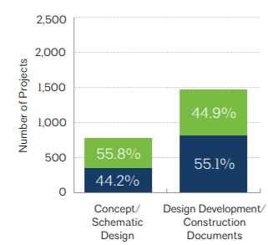
When is Energy Modeling Typically Done?
HIGH
Performance
Impact
Typical energy modeling timeframe
Level of Effort /
Performance
Level of Effort
LOW
Project
Start
Time
Project
Finish
© AIA 2030 Commitment, 2014 Progress Report

Slide 18
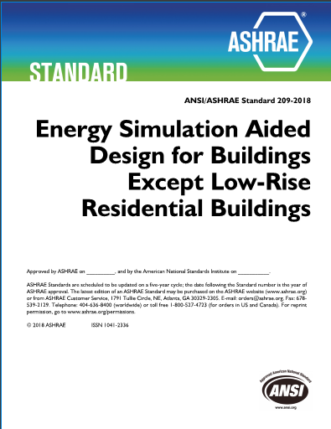
ASHRAE Standard 209
Purpose
Define minimum requirements for providing energy design assistance using building energy simulation and analysis.
Scope
This standard applies to new buildings or major renovations of, or additions to, existing buildings utilizing energy simulation during the design process.
Anticipated use
Organizations that certify high performance buildings
Utilities and agencies that provide incentives for low energy buildings
Building owners and architects seeking a uniform way to specify a scope of work for building energy modeling
Notes:
You will notice that the title is similar to 90.1 and uses the term “simulation” instead of “modeling”. That is product of the time that this standard was first discussed both terms were used interchangeably but the content of next draft of the standard uses the term modeling exclusively to match the term used by the industry.
Also not that the scope applies to the same buildings as 90.1 also. That makes sense since modeling homes is usually done with different tools and using different approaches than commercial building modeling. This standard does not apply to single-family houses, multi-family structures of three stories or fewer above grade, manufactured houses (mobile homes) and modular homes
Also remember this is a standard not a guideline. It does not suggest what should happen but prescribes rules that must be followed if you want to say that you comply with the standard.

Slide 19
Standard 209 Organization
Purpose
Scope
Definitions
Utilization
General Requirements
Design Modeling Cycles
Construction Modeling Cycles
Post-Occupancy Energy Performance Comparison
19

Slide 20
How to Comply with Standard 209
Required: all of these activities
5.1 Simulation Software Requirements
5.2 Modeler Credentials
5.3 Climate and Site Analysis
5.4 Benchmarking
5.5 Energy Charrette
5.6 Energy Performance Goals in OPR
5.7 General Modeling Cycle Requirements
+
6.3 Modeling Cycle #3 Load Reduction Modeling
20
Notes:
These are the activities that all need to be done to fulfil the requirements of the standard. General Requirements must occur before or concurrently with your first modeling cycle. The only required modeling cycle is Cycle #3 Load Reduction Modeling. To comply with the standard you must perform that modeling cycle.

Slide 21
How to Comply with Standard 209
Required: one of the following
5.7
+
6.1 Modeling Cycle #1 – Simple Box Modeling
5.7
+
6.2 Modeling Cycle #2 – Conceptual Design Modeling
5.7
+
6.4 Modeling Cycle #4 – HVAC System Selection Modeling
5.7
+
6.5 Modeling Cycle #5 – Design Refinement
5.7
+
6.6 Modeling Cycle #6 – Design Integration and Optimization
5.7
+
6.7 Modeling Cycle #7 – Energy Simulation Aided Value Engineering
21
Notes:
In addition, you must pick one other design modeling cycle. So along with modeling cycle #3, you can pick one of these. For each one that you do you need to meet the requirements of 5.7 which describe the generic modeling cycle.
Two cycles must be completed to comply with the standard: Load Reduction Modeling and one of these other design modeling cycles. You get to choose like at a cafeteria.
Now there is no limit if your project needs to do more modeling cycles, that is great. You can follow our requirements and that would provide a common understanding of what those other modeling cycles are. It is very likely that Scopes of Work might specify certain modeling cycles. That is great too.

Slide 22
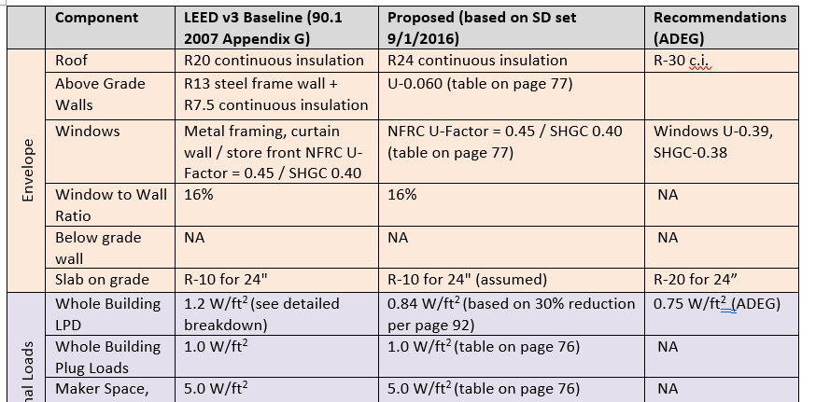
Performance targets and load reduction modeling example
Recommendations are set based on ASHRAE’s Advanced Energy Design Guides (AEDG), more recent editions of Standard 90.1, experience with past projects, etc.
22

Slide 23
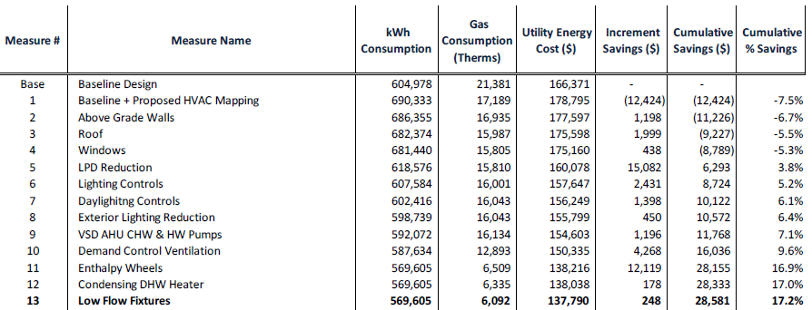
Design Refinement Example
23

Slide 24
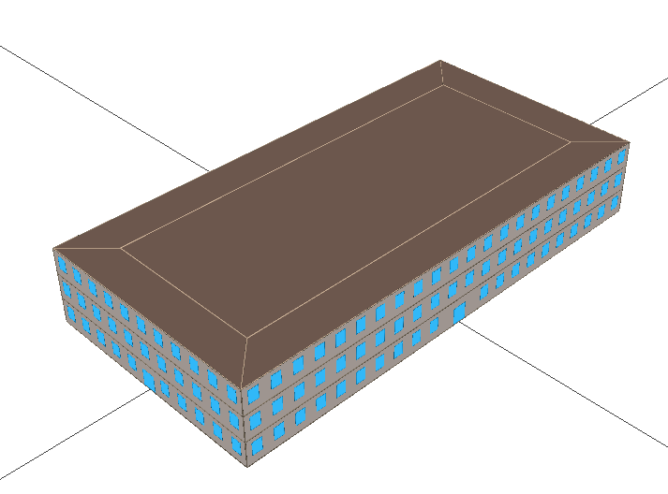
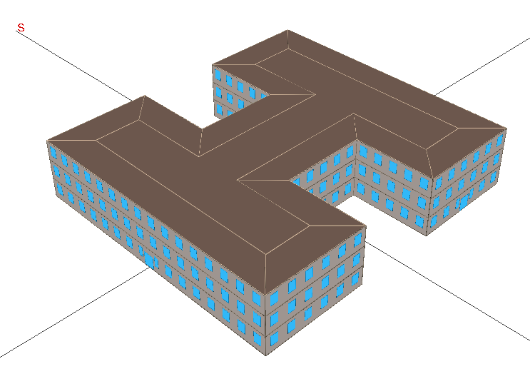
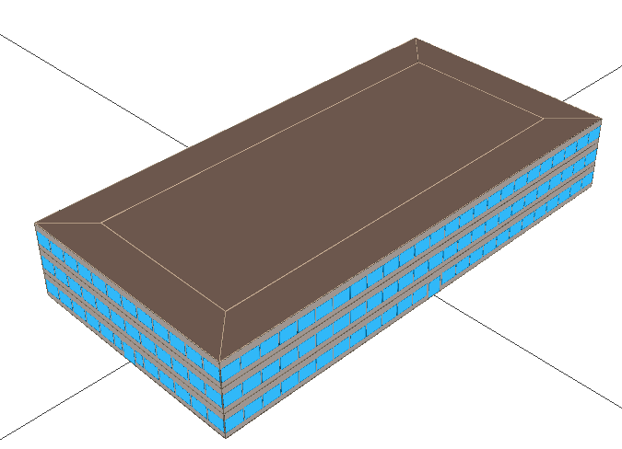
Simple box Modeling Example
Program calls for a 50,000 square foot office building
Base Case:
Rectangle 2:1 aspect ratio
3 story
25% window to wall ratio (WWR)
daylight dimming control
Alternative 2:
Same as base case, but 50% WWR
Alternative 1:
Same as base case, but H-Shape
 | Conditioned Floor Area, SF A | Surface Area, SF B | Area Ratio C=B/A | Window Area, SF
Base Case | 50,000 | 33,097 | 0.66 | 3,667
Alternative 1 | 50,000 | 38,598 | 0.77 | 4,907
Alternative 2 | 50,000 | 33,097 | 0.66 | 7,365
24
Notes:
Definitions:
Surface area – the area of all exterior surfaces that meet the outdoors
Area ratio – the ratio of a building’s surface area to its floor area
Heat loss = (A/R)x(T_{INDOOR}-T_{OUTDOOR}) where A = surface area and R = R-value of exterior constructions.
Traditionally, the focus is on increasing the R value to decrease heat loss.
An alternative, and complimentary, approach is to decrease the surface area by changing the building shape. Decreasing surface area has the additional advantage of reducing construction cost, where increasing R-value has incremental cost.
See Green Building Illustrated (Ching and Shapiro, 2014) for more discussion

Slide 25
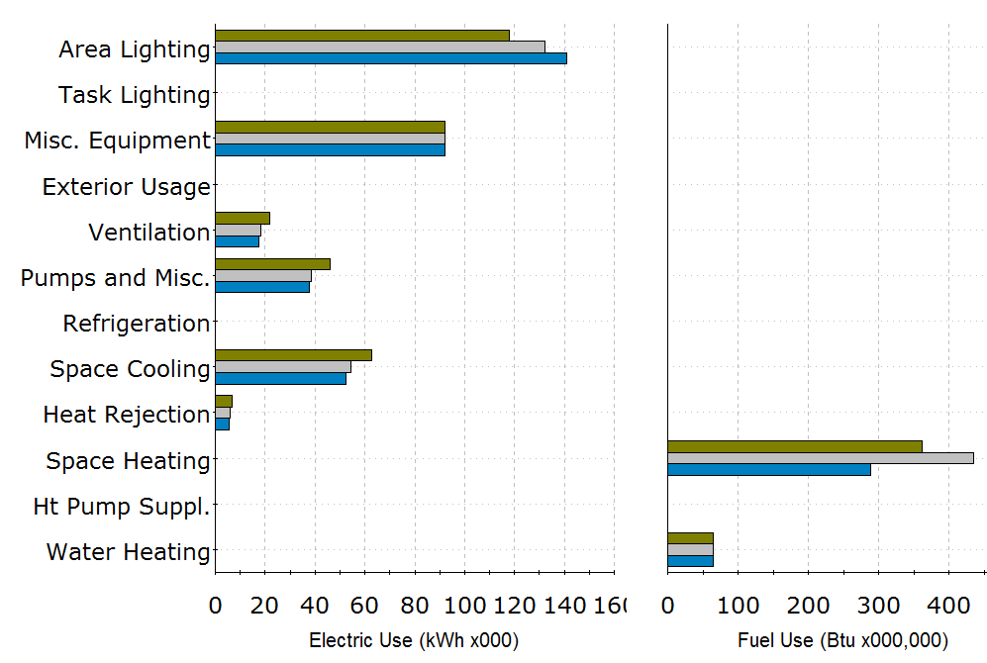
Which Alternative is More Efficient?
Baseline
Alt-1: H-shape
Alt- 2: 50% WWR
25

Slide 26
HVAC System Selection modeling Example
Compare HVAC design alternatives for a major renovation of a high school
Baseline VAV
Variable Air Volume (VAV) air handlers, water cooled chillers and conventional hot water (HW) boilers
Optimized VAV
VAV with HW condensing boilers and air-cooled, magnetic bearing chillers & improved controls
CB + CV DOAS
Chilled Beams (CB) with condensing boilers and air-cooled magnetic bearing chillers; constant volume (CV) dedicated outdoor air system (DOAS)
VRF + VAV DOAS
Variable refrigerant flow (VRF) heat pumps with variable volume DOAS

Slide 27
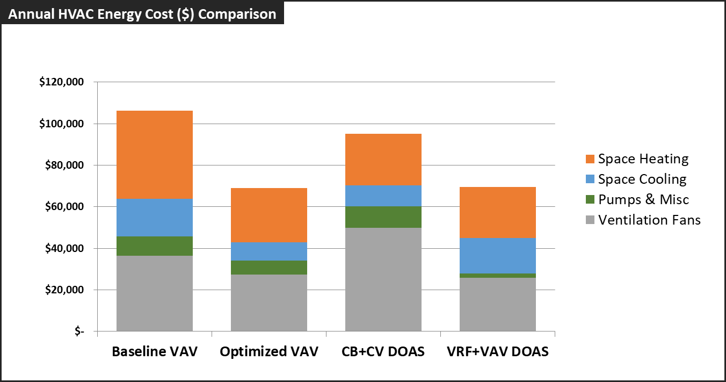
RESULTS

Slide 28
How to Comply with Standard 209
Optional (if required by adopting authority)
5.7
+
7.1 Modeling Cycle #8 – As-Design Energy Performance
5.7
+
7.2 Modeling Cycle #9 – Contemplated Change Orders
5.7
+
7.3 Modeling Cycle #10 – As-Built Energy Performance
5.7
+
8. Post-Occupancy Energy Performance Comparison
28
Notes:
While two cycles must be completed to comply with the standard, some programs may want to go further and for them they can specify one of these steps which would only be required if the program that adopts Standard 209 uses them. For everyone else, these are optional. A good idea, and now they are described in a specific way so that it is easier to communicate with clients and the design team on exactly the kind of work that is being done.

Slide 29
Interpreting Simulation Results

Slide 30
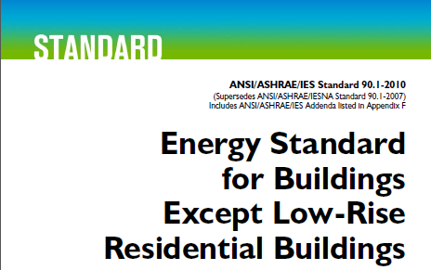
Does Modeling Protocol Affects Projected Performance?
New York State Energy Research and Development Authority (NYSERDA) funded a study to examine equivalency of ASHRAE Standard 90.1 Appendix G, PHIUS+, and PHI modeling protocols to inform technical requirements of the multifamily program.

Slide 31
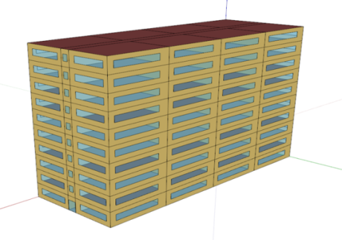
Study Methodology
Model the same building designs in the three protocols
Compare projected performance
If projections differ, understand sources of the difference
Develop an approximate mapping between protocols
Standard 90.1 Performance Rating Method

Slide 32
Case Study Description
Building shape and floor plan based on the Pacific Northwest National Lab (PNNL) high-rise apartment multifamily progress indicator model
84,360 sf² 10-story
79 apartments
Windows account for 30% of gross exterior wall on each exposure
Slab-on-grade foundation

Slide 33
Evaluated Configurations
Base Case: All systems minimally compliant with ASHRAE Standard 90.1 2010; heating, cooling and ventilation by Package Terminal Air Conditioners (PTACs)
Packages A, B, & C: Base Case with the features commonly seen in the projects that exceed code but are below the passive house standards; additional packages with features found in the best projects that exceed passive house standards
Each configuration was documented in the level of detail typically found in the Construction Documents.

Slide 34
Modeling Protocols and the Teams
 | Guiding Documents | Simulation Tool
90.1 PRM | ASHRAE Standard 90.1 2010 Appendix G; EPA Energy Star MFHR Simulation Guidelines | eQUEST v3.65
PHIUS | PHIUS+ 2015 Certification Guide Book V1.01 | WUFI V.3.0.3.0
PHI | PHPP v9.5 – PH Classic | PHPP v9.5
All materials including the models and analysis were shared between the teams to enable peer review.

Slide 35
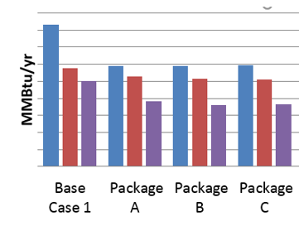
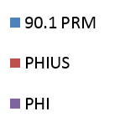
Modeled Annual Source Energy Use
* Site-to-source energy conversions on all graphs are based on the EPA Portfolio Manager
Notes:
Appendix G protocol results in higher (more conservative) usage across the board, followed by PHIUS, and then PHI. The difference in results between the protocols is significant, for example the total source energy for the Base Case 1 (configuration minimally compliant with 90.1 2010) following the Appendix G protocol is almost twice that of PHI.

Slide 36
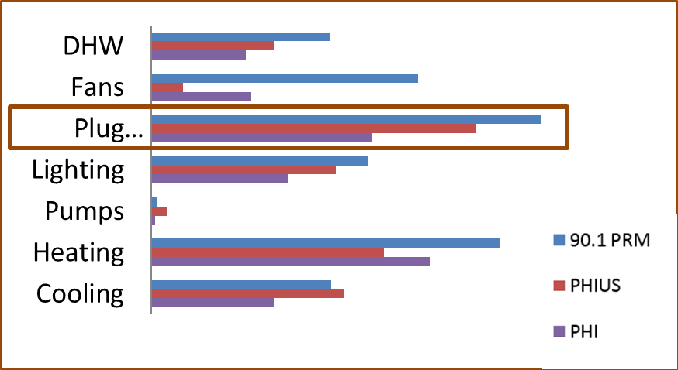
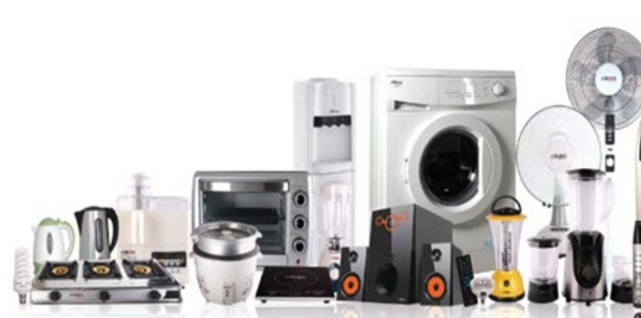
Base Case Source Energy: Plug Loads
Notes:
Plug Loads category accounts for the largest share of electricity consumption with all protocols, but its magnitude varies significantly. The usage associated with plug loads in PHI models is about 50% less than the plug loads with Appendix G protocol, and PHIUS plug loads are 17% lower than Appendix G. This end use category includes elevator, kitchen appliances, consumer electronics, and miscellaneous other equipment that is not shown on drawings but is typically present in multifamily buildings and contributes toward building’s electricity usage. Except for the elevator, these loads were not included in the case study description, and were based on the defaults prescribed by each protocol. Even though variations in this category are expected due to differences in the protocols’ assumptions, the magnitude of the difference, especially for PHI protocol, appears excessive and warrants further investigation. Aside from affecting the total electricity consumption, plug loads interact with heating and cooling, so should be estimated realistically.

Slide 37
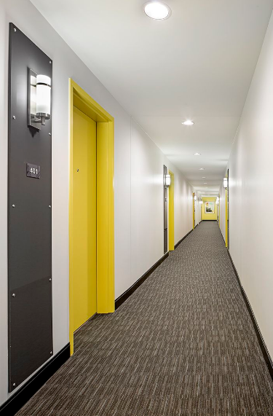
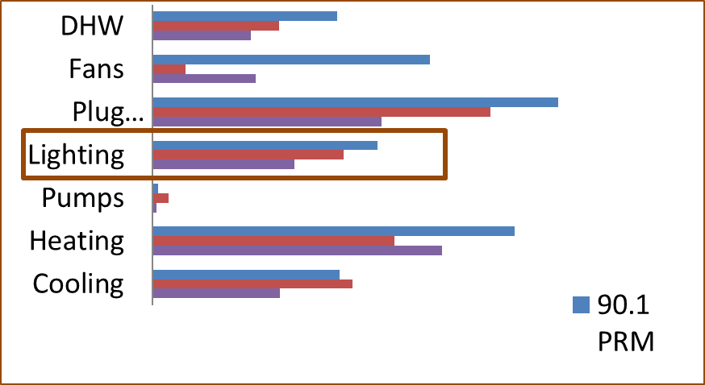
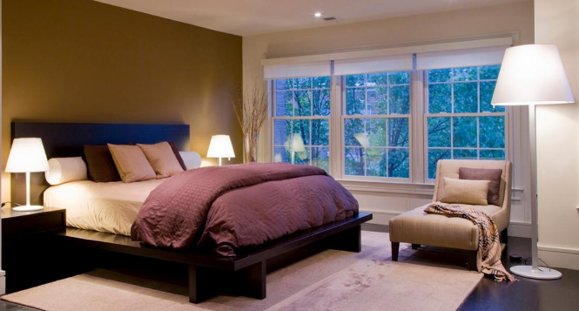
Base Case Source Energy: Lighting
* Site-to-source energy conversions based on the EPA Portfolio Manager
Notes:
Lighting is the third largest electricity end use for Base Case, and the second largest for most packages. There is a notable difference in how in-unit lighting is treated by Appendix G protocol compared to PHIUS and PHI. With Appendix G, it was modeled based on the maximum lighting power density prescribed for multifamily buildings in NYS ECCC. Performance credit is allowed only for hard-wired fixtures shown on drawings, and typically only in spaces where lighting is fully specified (e.g. bathrooms, kitchens, closets) and meets IESNA-recommended illuminance levels. No performance credit can be documented for spaces where tenants’ plug-in lighting fixtures are typically used (e.g. living rooms and bedrooms). On the other hand, both PHI and PHIUS protocols use lighting usage (kWh/hr) based on the default assumptions irrespective of whether any fixtures are specified.

Slide 38
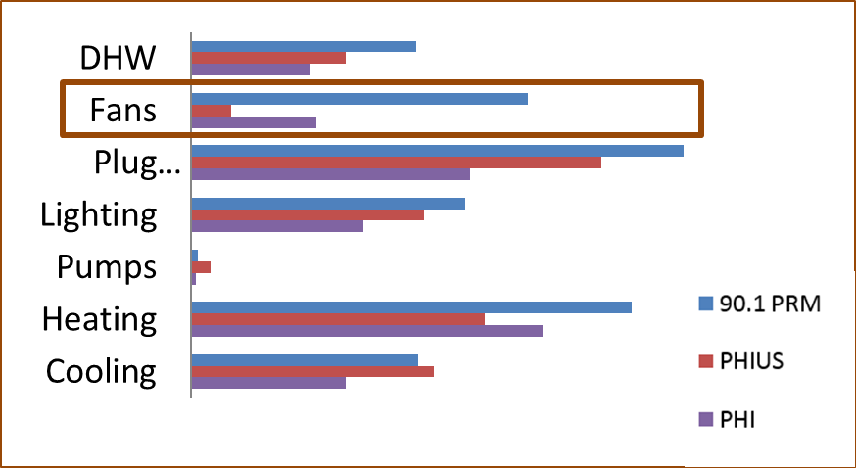
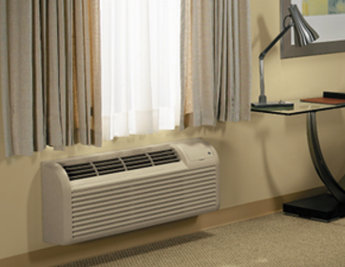
Base Case Source Energy: Fans
Notes:
Fan energy is higher in Appendix G models compared to PHIUS and PHI models for all packages, which is expected since simulation tools used by PHI and PHIUS protocols do not model heating/cooling fans explicitly, but instead include them in the cooling end use. ASHRAE 90.1 requires that fan energy is extracted from efficiency ratings and modeled explicitly, which allows capturing continuously running heating/cooling fans such as in the PTACs for the Base Case, and fan energy consumption associated with heating. This is further discussed in the section about tool capabilities.

Slide 39
Key Reasons for the Difference: Modeling Assumptions and Rules
PH protocols have significantly more optimistic assumptions for systems and operating conditions not inherent in design compared to EPA MFHR. Examples include …
in-unit lighting
plug loads
hot water use
credit for the manual controls (90.1 credits automatic controls only)

Slide 40
Key Reasons for the Difference: Simulation Tools Capabilities
WUFI and PHPP were designed to model high performing buildings with relatively simple mechanical systems, and do not meet many of the simulation tool capabilities required by ASHRAE Standard 90.1.
Sample limitations that affected the case study:
could not explicitly model different mechanical systems serving common corridors (e.g. gas-fired RTU) versus apartments (e.g. VRF heat pumps)
continuously running heating & cooling system fans (e.g. in PTACs in the Base Case) were not captured

Slide 41
Watch out for the Units!
Each protocol may express building performance using different units – site or source energy use intensity (EUI), energy cost, etc..
If source (primary) energy units are used, site-to-source conversions may differ significantly between protocols
Conversions are periodically updated, e.g. PHI introduced Renewable Primary Energy Demand (PER) with conversions dependent on the climate zone and end use.
 | [Source BTU] / [Site BTU]
 | EPA Portfolio Manager | PHIUS | PHI
Gas | 1.05 | 1.1 | 1.1
Electricity | 3.14 | 3.16 | 2.6
.

Slide 42
So Which Protocol Got it Right?
The actual performance of the proposed design will differ from the modeled performance due to the following:
variations in schedule of operation and occupancy
building operation and maintenance
weather
10 year historical weather average ≠ 2020 weather
changes in energy rates
2017 electricity and gas cost ≠ 2020 costs
tenant equipment
the precision of the simulation tool
THESE FACTORS AFFECT ALL PROTOCOLS

Slide 43
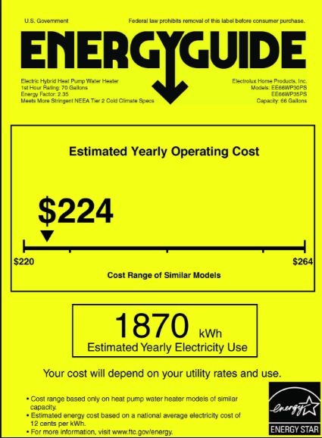
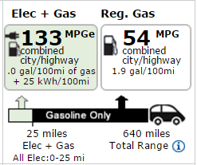
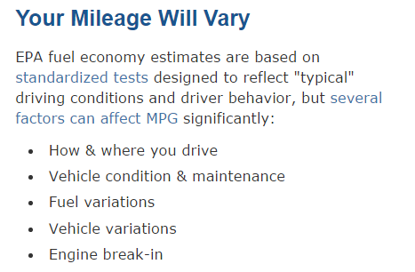
If Modeled Performance Cannot Pinpoint Actual Performance, then Why Bother?

Slide 44
Takeaways
Modeling may be used to document compliance with the energy code, incentive program participation, and in programs for green buildings such as LEED
Modeling is the most effective when used as design optimization tool
ASHRAE Standard 209 should be used to communicate the required modeling scope on projects
Consumers and design professionals should be educated about the nature of modeled performance

Slide 45
Financing Opportunities Unlocked through Modeling

Slide 46
About the Connecticut Green Bank
Support the strategy to achieve cheaper, cleaner, and more reliable sources of energy while creating jobs and supporting local economic development
Attract and deploy private capital investment to finance the clean energy policy goals for Connecticut
Leverage limited public funds to attract multiples of private capital investment while reinvesting public funds over time
Develop and implement strategies that bring down the cost of clean energy in order to make it more accessible and affordable to customers
Support affordable and healthy homes and businesses in distressed communities reduce energy burden and address health & safety
46
Notes:
Anthony
$1.3B -- $219M CGB and $1.1B private
30K+ families and 300+ businesses

Slide 47
Connecticut programs reward high performance projects and new construction
Helping Developers Build Better
Supporting Early Design Work
Employing Robust Technical Analysis
Rewarding High Performance
Encouraging development of higher performing ground-up and renovation projects
Focusing attention on high-impact changes at an early stage
Using whole building energy performance modeling and measure assessment
Providing more resources as energy performance improves or moves beyond code
47

Slide 48
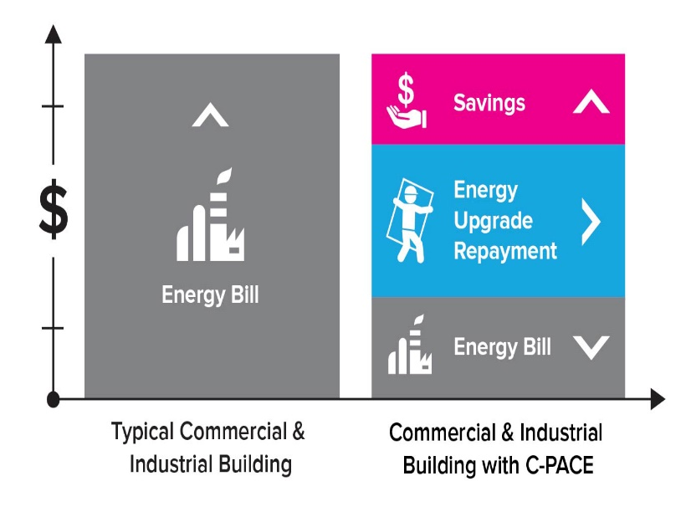
Making the Case for Commercial PACE (C-PACE)
Financing clean energy projects through C-PACE can:
Increase asset value
Improve free cash flow
Preserve cash and credit for core
business investments
Solve deferred maintenance needs
For retrofit projects
Displace higher cost debt in the capital stack
48
Notes:
Michael

Slide 49
C-PACE New Construction ProcesS
On-site generation (e.g. solar) are evaluated separately when determining performance beyond code and total C-PACE eligible financing amount
49
Notes:
Anthony

Slide 50
GREEN BANK Multifamily Pre-development Loan Programs
Navigator Loan Program
Type
Rate
Loan Process
Pre-development
Affordable properties 1.99%;
Market-rate properties 3.99%
Client pays 25%; program loans 75%
Owners select their own energy professionals
Sherpa Loan Program
Type
Rate
Loan Process
Pre-development
Affordable properties 1.99%;
Market-rate properties 3.99%
Client pays 25%; program loans 75%
Funds technical assistance by New Ecology, Inc.
To fund energy-related assessments, audits, and design.
Passive House → ability to fund more $$$
Notes:
Put in same format as project financing terms (slide 20)
Standardize format – same as term financing
Old content:
Client pays 25% of pre-development costs; program loans 75%
Cost share interest rates
Affordable properties: 0%
Market rate properties 2.99%
Loan repayment due in 24 months or upon project financing
No fees, unsecured
If project unable to proceed, owners may request/receive loan forgiveness

Slide 51
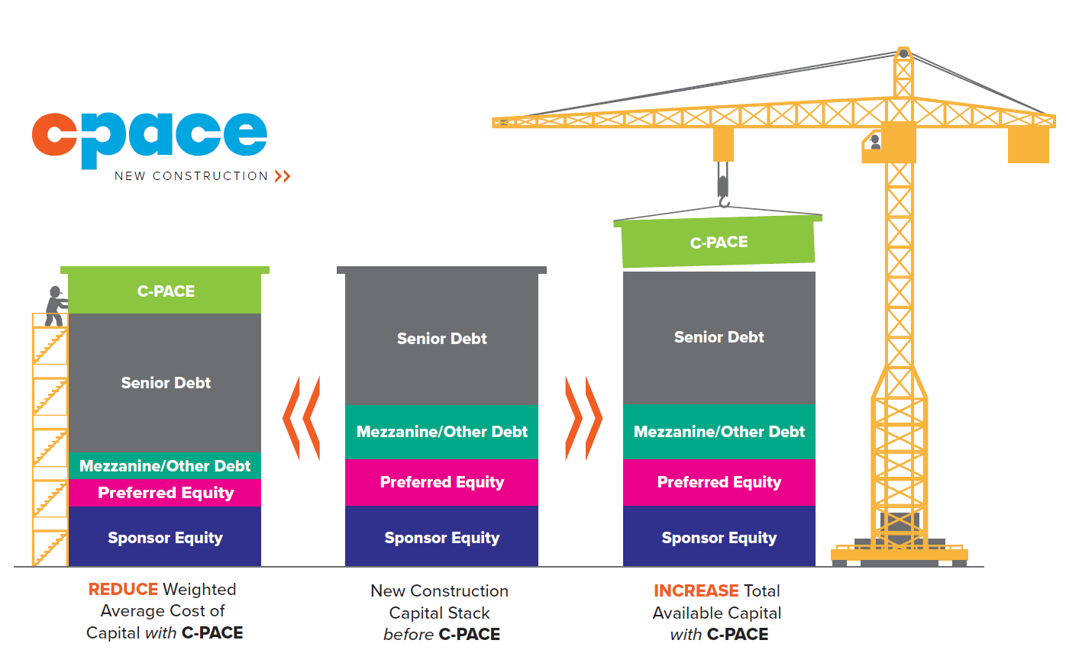
Completing or Improving the Capital Stack with C-PACE
51
Notes:
Anthony

Slide 52
Connecticut Utility Incentives
For the latest information regarding new construction incentives and availability from Eversource and United Illuminating visit EnergizeCT.com/EnergyConsciousBlueprint
Larger, more complex
2018 Design Incentives
Brainstorming Energy Charette | $2,500
Energy Model Incentives | $15,000 – $20,000
≥ 15% Energy Savings | $.20/sf*
Path to Net Zero ≥35% | $10,000
2018 Installation Incentives
Savings Above Code | $/sf
≥ 10% - <15% | 0.50
≥15% - <20% | 0.75
≥20% - <25% | 1.25
≥25% - <30% | 2.25
≥30% | 3.00
LEED Enhanced Commissioning | 10% of incentive up to $15,000
Certification Bonus (LEED & Green Globes) | $5,000 - $15,000
Minimum 30,000 SF
Early in design process
Undergoing standardized modeling & reporting
*Subject to program caps up to a maximum of $15,000.
52
Notes:
Anthony

Slide 53
QUESTIONS
53
Notes:
Anthony

Slide 54
Thank you.
Maria Karpman
maria@karpmanconsulting.net
Anthony Clark
anthony.clark@ctgreenbank.com

